Slide 1
Transit For Higher Education Conference
Presentation By: The Transit Access Club

Slide 2
A bit about the Transit Access Club
TAC is an SRJC transit advocacy club
We are Providing student oversight on the use of the SRJC transportation fund
We are calling for safe, efficient, reliable access to all five of the SRJC campuses
Our transportation fee pays for contracts with local transit agencies- we effectively self tax ourselves and deserve bettter access
We are active in the community
TAC has made many connections throughout Sonoma County. These conversations are centering student access, and allowing for creative solutions.
Our main goal: achieve reliable student access to efficient, affordable, and sustainable methods of transportation…

Slide 3
About our Conference…
In collaboration with the SRJC transportation department, TAC is hosting a luncheon on the Petaluma campus on April 10th
Local transit executives, student leaders, administration, advocacy groups, government representatives will be in attendance
Collaborative discussions featuring each campus will focus on how Sonoma County can better serve SRJC students.
GOAL: using our peak hour student data, and breakout group discussions, transit agencies will develop modified routes to better serve our community; follow up meeting scheduled for May 1st.
APRIL 10TH, 2026 12:30-3:30PM

Slide 4
We need your help!
Student volunteers are vital to the success of this event!
Are you an exceptional notetaker?
Do you love urban planning puzzles?
Are you involved in SRJC journalism?
Do you have experience in hospitality or food service?
Are you passionate about advocacy?
Are you a photographer?
Are you an audio tech wizard??

Slide 5

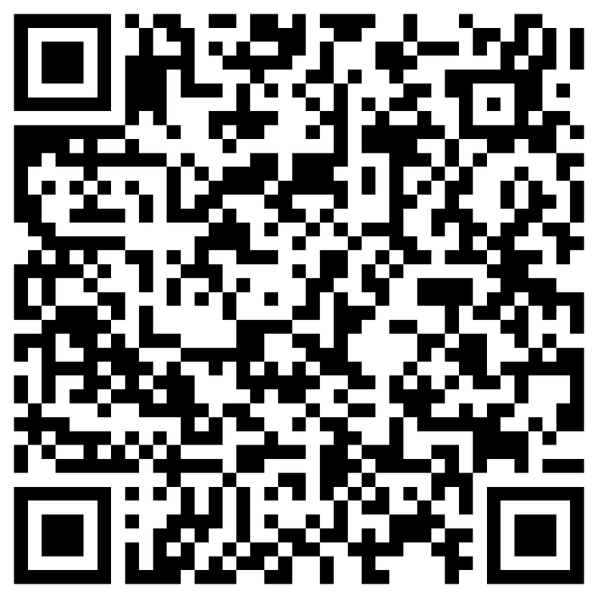
Are you available Friday April 10th ?
Free lunch! Free Parking! Your instructors may be offering extra credit! Ask them!
We could have so much fun together demanding functional transit from our local representatives!
SIGN UP TO BE A VOLUNTEER! AT OUR CONFERENCE!

Slide 6



Other ways to support us??
TRANSIT SURVEY
SRJC TRANSIT ACCESS CLUB SPRING 2026
Preguntas de la Encuesta de Transporte
Por SRJC Transit Access Club: Primavera 2026
Fill out our SRJC transportation Survey!
Your voices are vital in creating regional change!!! Your Input matters!!
TRANSIT ACCESS
CLUB
TRANSIT ACCESS
CLUB
INSTAGRAM: @transit_srjc
INSTAGRAM: @transit_srjc

Slide 7
Fill out our SRJC transportation survey!
Follow us on instagram! @transit_srjc
even more ways you can support TAC!
Come to our weekly meetings!
Friday at noon (on Petaluma campus or zoom)
Check out our club page on the ICC website for all relevant info or email the club email!
TransitAccessClub@gmail.com

Slide 8
Closing thoughts
Currently, most students who use public transportation only use it because they don’t have another option…
Access to affordable transit means access to education.
Access to efficient transit means access to employment.
Access to reliable transit means access to affordable housing.
Access to reliable transit means access to medical care.

Slide 9
Thank you!!
Email
TransitAccessClub@gmail.com
Instagram
Google form for volunteer sign up here!!
@transit_srjc

